Slide 1
HTML/CSS web portfolio
Phillip Yoo

Slide 2
Walkthrough
Single page scroll-down website
Website was divided into five sections
About me(front page)
Skills
Projects
Blog
Contact
Each section was imported and linked internally to the main page(index.html) through the use of some javascript

Slide 3
Features
Navigation bar
Each button linked to sections below
Smooth scroll-down
Sliding animation
As the pointer hovers around project images a brief description slides up
Contact form
Name, email and enquiry form made for users with further interest along with a submit button below

Slide 4

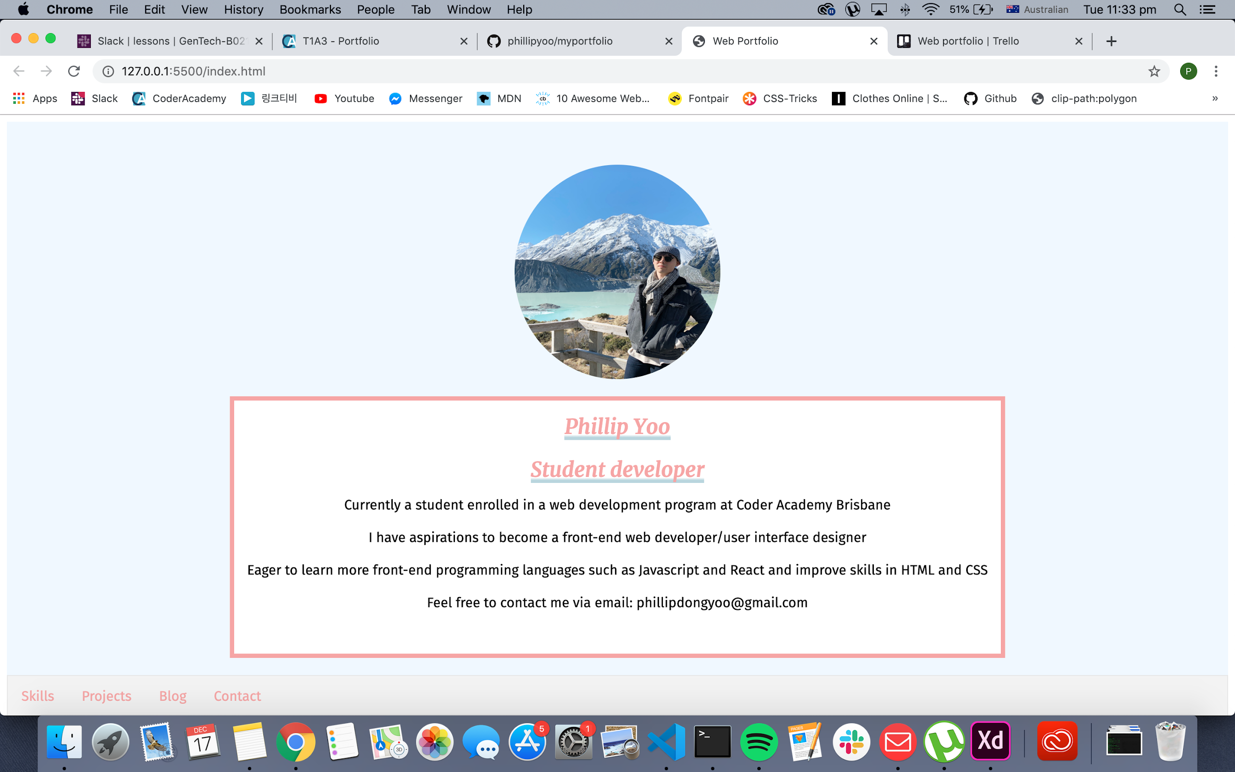
Design process
Never ended up making a moodboard until website was complete
Adobe XD used to create wireframes
Design begun by looking for a background colour that would match my display picture (#f0f8ff:”Alice blue”)
Other background colors used:
White smoke (#F3F3F3)
Underline highlights created so headings can stand out
Text colour used:
Pale red (#F5A5A5)
Fonts found in Google fonts:
Merriweather, serif
Fira-sans, sans-serif

Slide 5
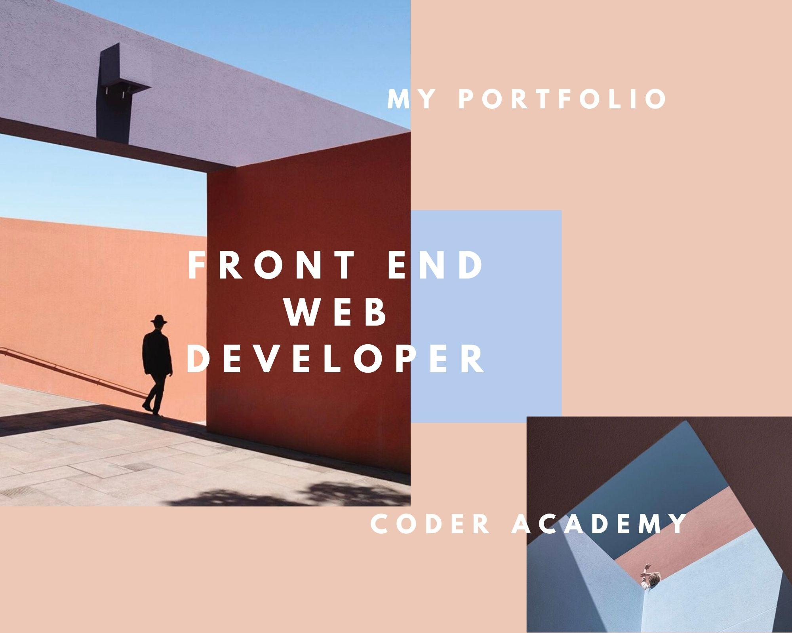
Moodboard

Slide 6
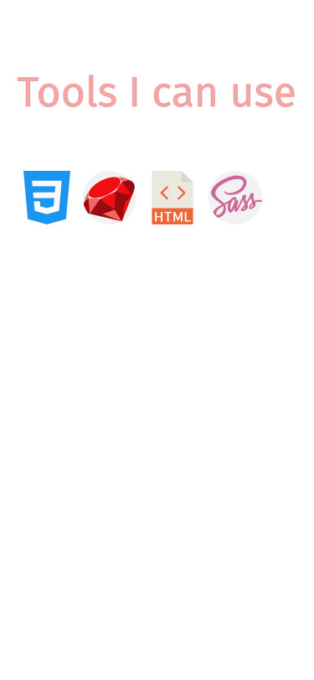
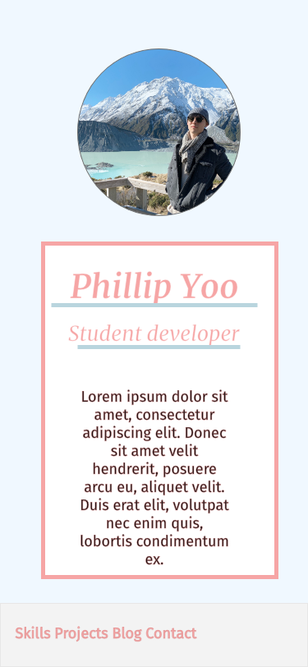
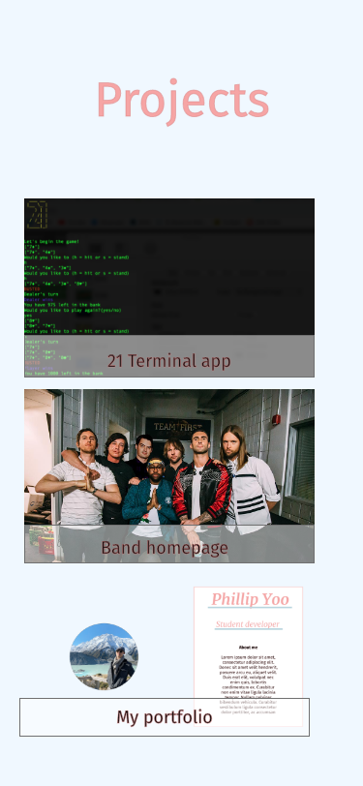
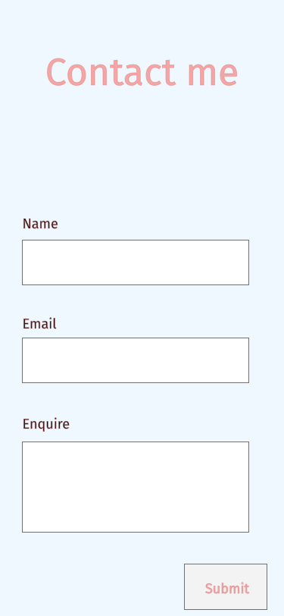


Slide 7
Issues/
Challenges
Began creating a wireframe to get a rough sketch of user interface
Challenges
Sticky nav-bar
Hover sliding animation
Built webpage for mobile interface first
After that images were enlarged and flexboxes were added to make website responsive to ipads and desktops

